Slide 1
Multiple memory systems in category learning
Nicolás Marchant

Slide 2
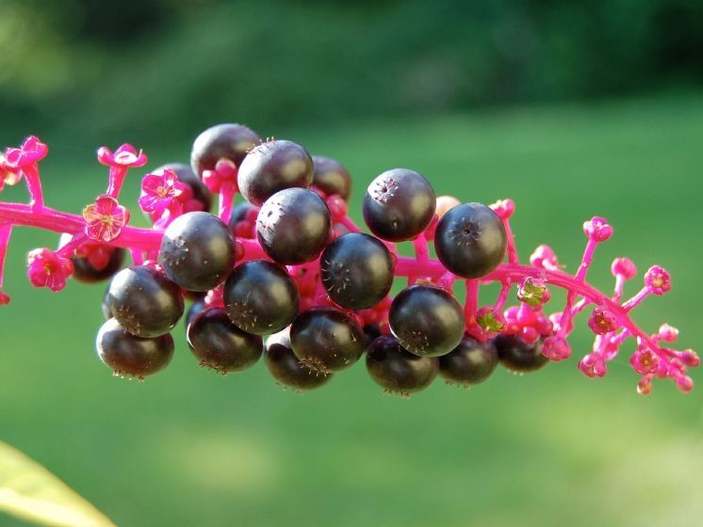
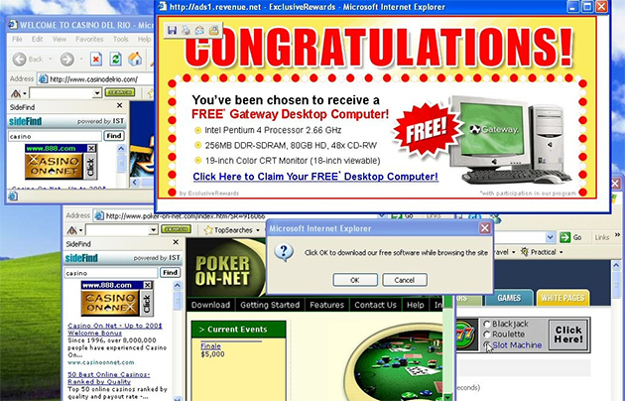
What is category learning?
Category learning is the ability of an organism to learn to classify an item or events into groups (Seger & Braunlich, 2015).
The grouping experience come along with a wide range of phenomena from the most concrete/literal (e.g., color) to the more abstract (e.g., peace, love, democracy). (Seger and Miller, 2010).
In cognitive neuroscience, a wide variety of task are performed under the category learning paradigm.

Slide 3
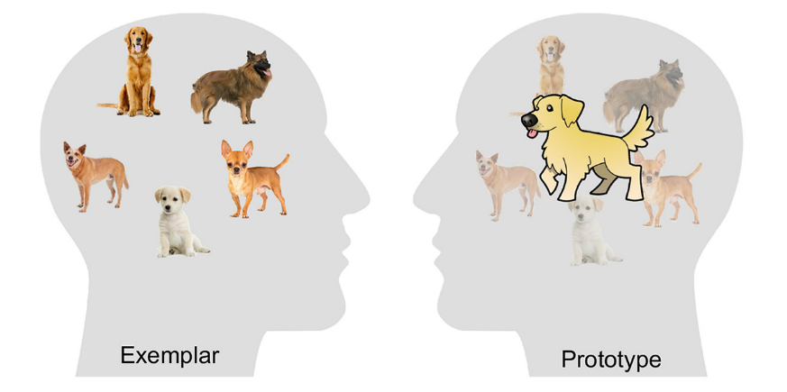
Classical theories
Prototype: An abstract representation is formed by computing a central tendency from all features of previous exemplars (Posner & Keele, 1968; Rosch & Mervis, 1975).
Exemplar: People represent their categories by storing every individual exemplar in memory through stimulus similarity (Medin & Schaffer, 1978; Nosofsky, 1984; 1986).
Decision bound: Due to the trial-by-trial variability in perceptual information, subjects learn to assign responses into different regions of the perceptual space (Ashby & Gott, 1988; Maddox & Ashby, 1993).
Zeithamova, et al., (2019).

Slide 4
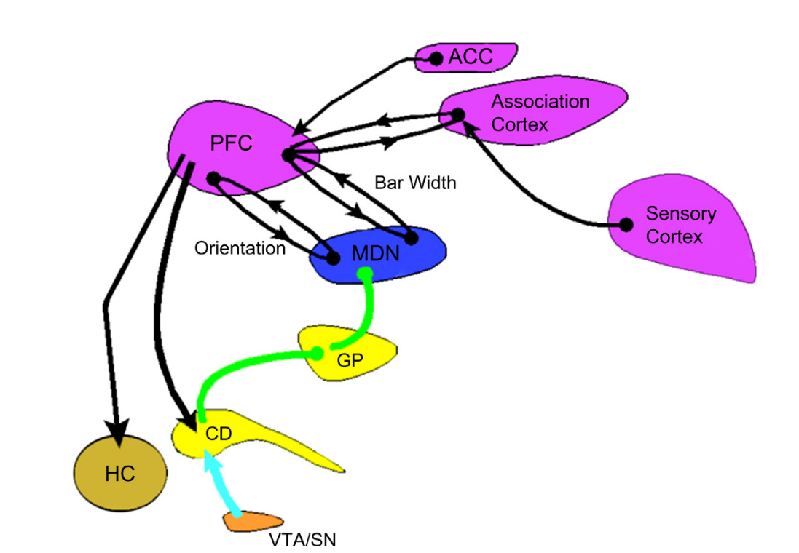
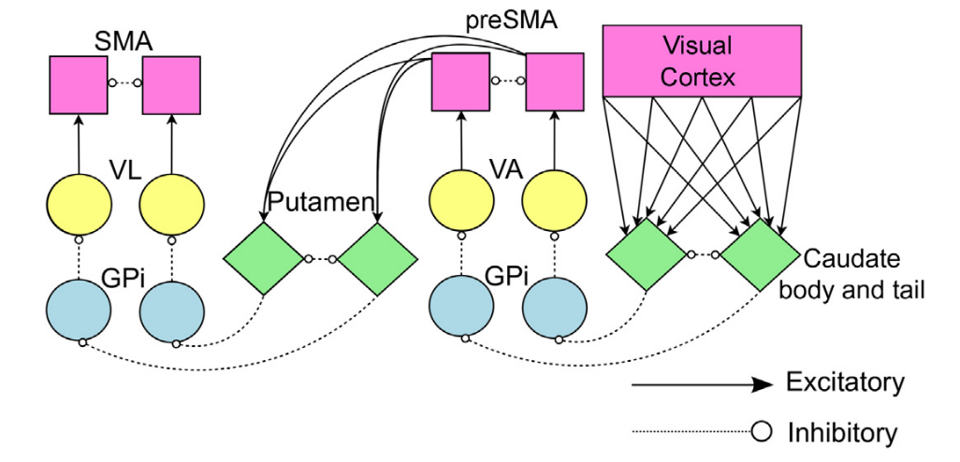
Multi-modal approach
COVIS Theory:
Declarative system:
Procedural system:
Ashby & Valentin, (2017).
Notes:
The COVIS declarative system. Black lines5excitatory projections, green lines5inhibitory projections, teal line5dopminergic projection. ACC,anteriorcingulate cortex; CD, caudate nucleus; GP, internal segment of the globus pallidus; HC, hippocampus; MDN, medial dorsal nucleus of the thalamus; PFC, prefrontal cortex; SN, substantia nigra pars compacta; VTA, ventral tegmental area.
The architecture of the COVIS procedural category learning system that includes two stages of learning. GPi, internal segment of the globus pallidus; SMA, sup- plementary motor area; VA, ventral anterior nucleus of the thalamus; VL, ventral lateral nucleus of the thalamus

Slide 5
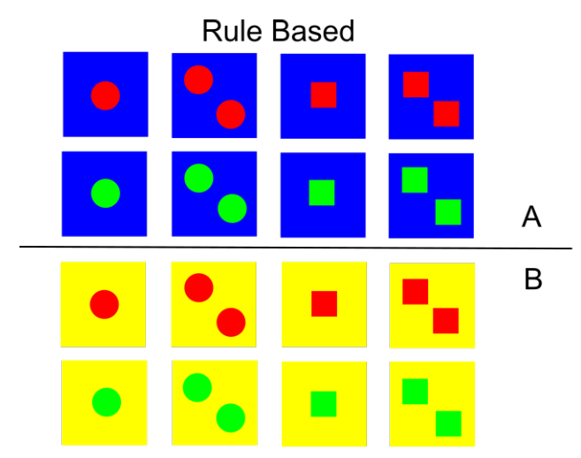
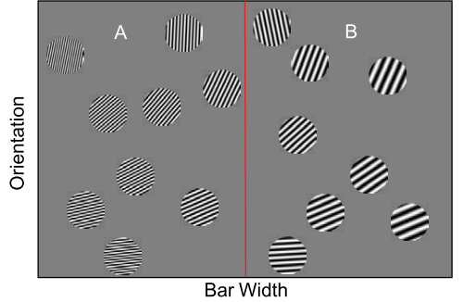
Category learning task: Rule-based
Rule-based (RB) task are those where subjects can easily verbalize the decision criteria.
Category rules are learning via explicit reasoning (conscious activation) (Ashby, et al., 1998)
RB task correlates with declarative memory systems (e.g., working memory, episodic memory and semantic memory).
Patients with PFC damage have working memory impairments and also RB category learning deficits (Ashby & O’Brien, 2005).
Ashby & Valentin, (2018).
Ashby & O‘Brien, (2005).

Slide 6
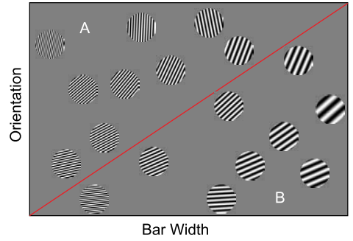
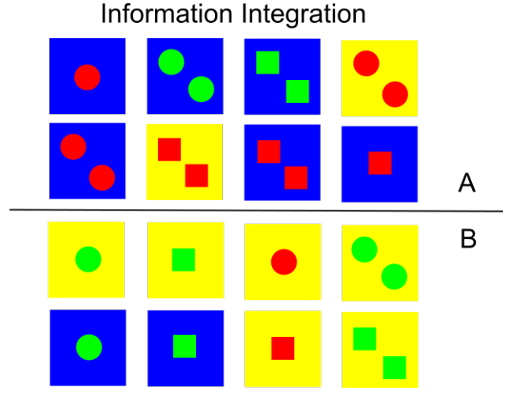
Category learning task: Information integration
Information integration (II) task are those were perfect accuracy can only be achieved if two or more dimensions are integrated at some pre-decisional stage.
II task are impossible or very difficult to verbalize (Ashby & Maddox, 2005).
II task correlates with procedural memory (e.g., skills that are acquired through practice) (Ashby & O’Brien, 2005).
Procedural memory is mediated by the basal ganglia (BG). Impairments in BG (e.g., Parkinson disease and Huntington’s disease) causes deficits in II task. (Ashby & O’Brien, 2005; Seger & Miller, 2010)
Ashby & O‘Brien, (2005).
Ashby & Valentin, (2018).

Slide 7
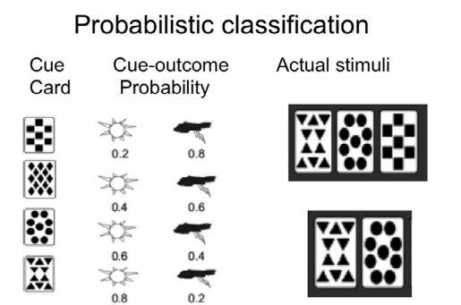
Category learning task: Probabilistic
The weather prediction task (WPT) combines probabilistic feedback with stimuli that vary on binary-valued dimensions (Knowlton, Squire & Gluck, 1994).
WPT correlates with the medial temporal lobes (hippocampus) and the basal ganglia (Ashby & Maddox, 2005; Seger & Braunlich, 2015). But this is an ongoing debate.
Extended training shows deficit in amnesiac patients (Ashby & Maddox, 2005).
Seger & Braunlich, (2015).
Notes:
Aún es debatido si es mediado completamente por los lobulso temporales o por la BG

Slide 8
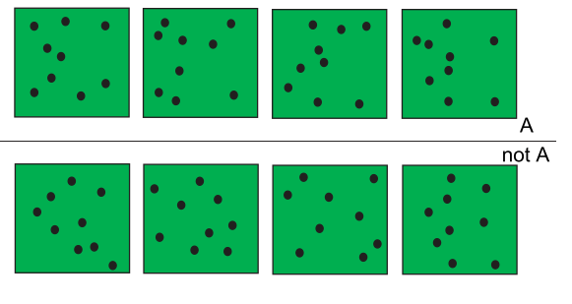
Category learning task: Prototype distortion
In prototype distortion (PD) task, the category exemplar are created by randomly distorting a single category prototype (Ashby & Maddox, 2005).
PD typical procedures: A, not A; A, B; Inference (Ell, et al., 2017).
Ashby & O‘Brien, (2005).
Notes:
Cognitive neuroscience theories postulate that the learning that underlies the PRS occurs within visual cortex [1,54,55]. The idea is that repeated presentations of the same stimulus during some relatively brief time interval enhance the firing of the visual cortical unit that is maximally sensitive to that stimulus [56]. Such enhanced sensitivity could facilitate category learning only if many category exemplars are highly similar to some central prototype.

Slide 9
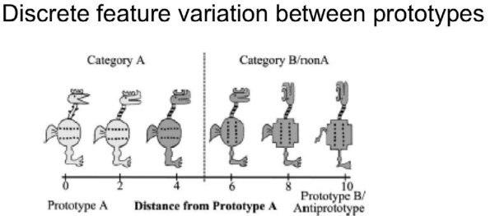
Category learning task: Prototype distortion
PD correlates with the Perceptual memory Representation System (PRS) that occurs within the occipital cortex (Ashby & O’Brien, 2005). Evidence is in favor with the A, not A.
Parkinson disease, schizophrenia, Alzheimer disease, shows normal A, not A. Amnesiac patients show normal A, not A but impaired A,B (Casale & Ashby, 2008).
Zeithamova, Maddox & Schnyer, (2008).
Seger & Braunlich, (2015).

Slide 10
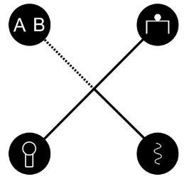
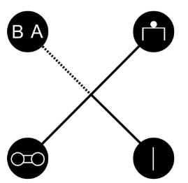
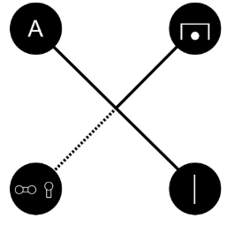
Prototype distortion and selective attention
Since Shepard, et al., (1961) selective attention is crucial in categorization environments.
Subjects learn how to allocate attention in order to improve performance in a categorization task (Nosofsky, 1984; Kruschke, 1992).
Rehder & Hoffman (2005) evidenced the used of eye-tracker in selective attention, favoring the exemplar theory.
Inference learning promotes a better category generalization, because promotes the knowledge of the internal category structure (Hoffman & Rehder, 2010)
Hoffman & Rehder, (2010).

Slide 11
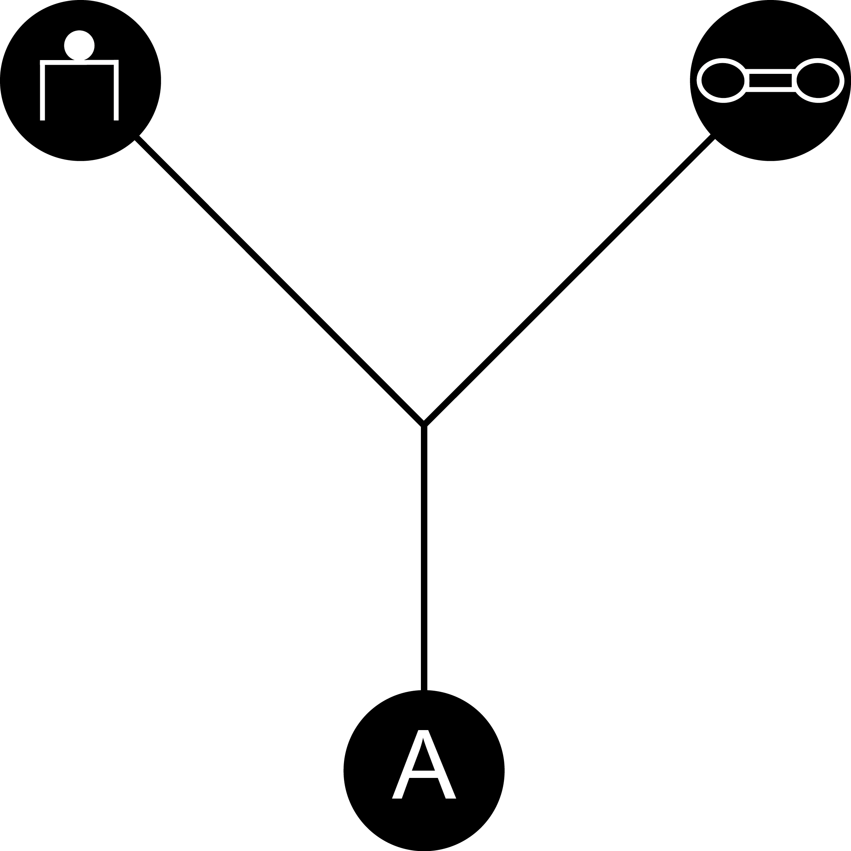
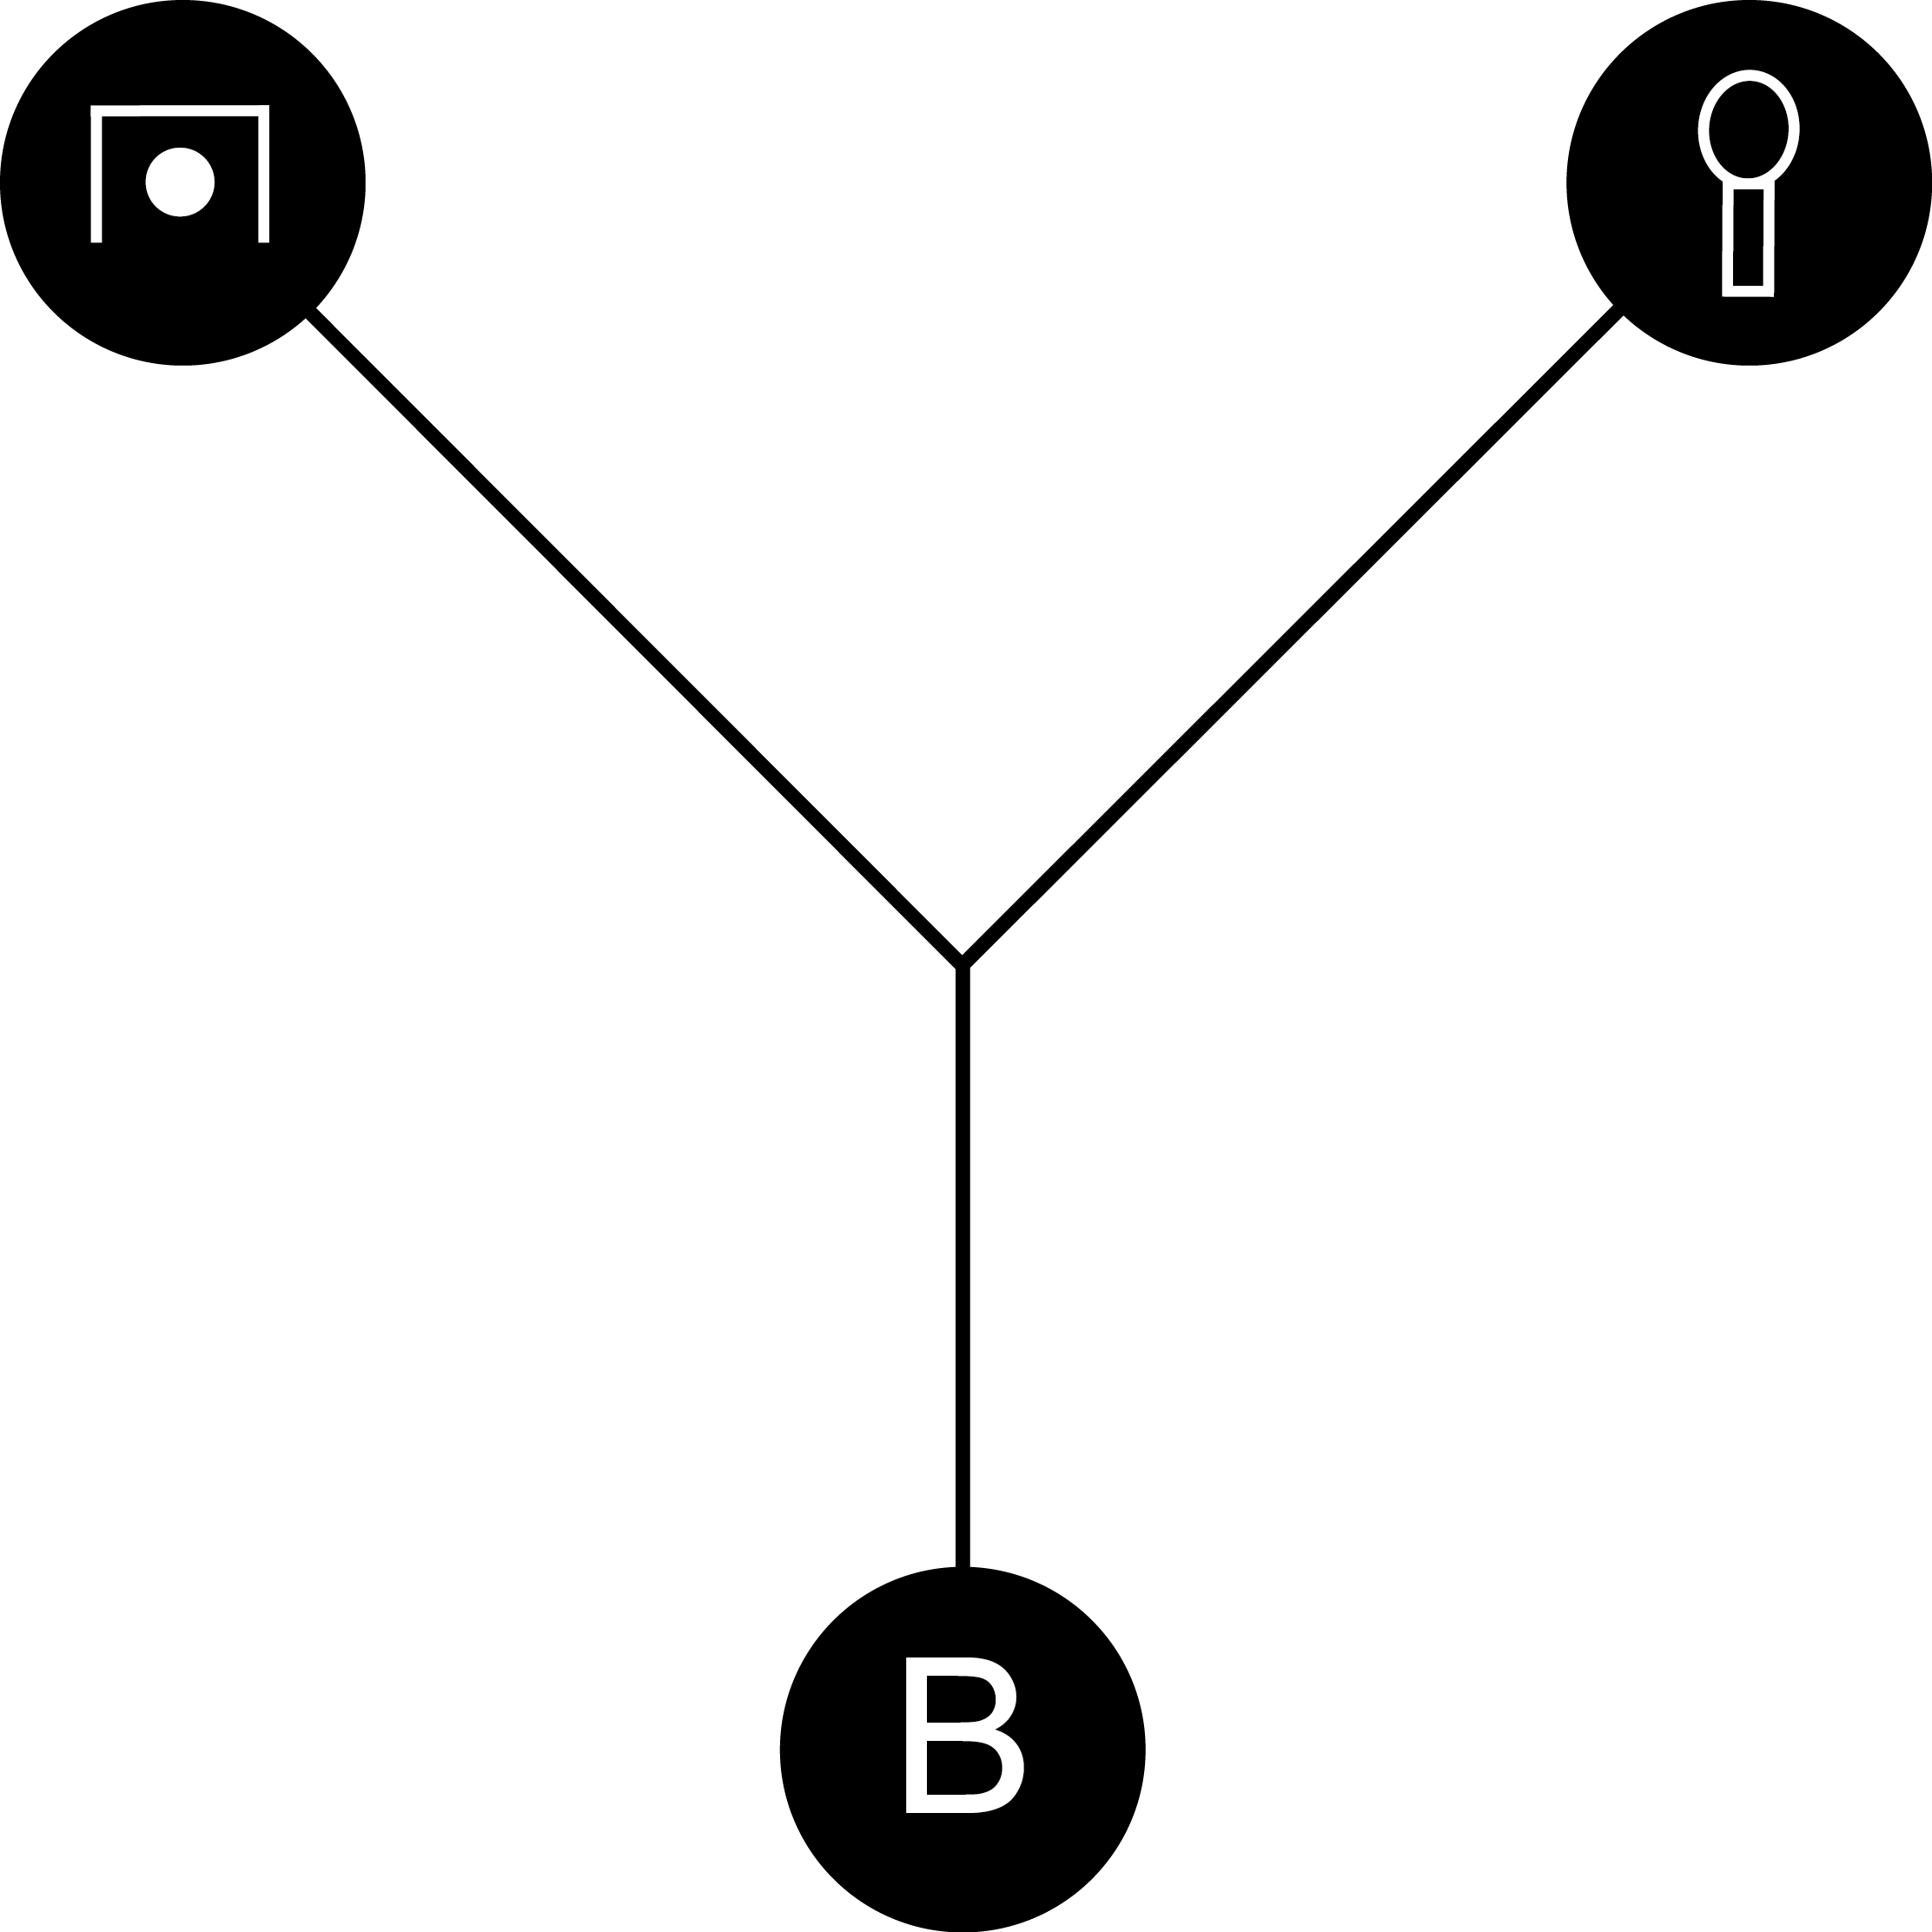
Current experiment
The proposed experiment combines an PD task with the WPT.
We elaborated two prototypical binary-valued ceremonial symbols (e.g., Hoffman & Rehder, 2010). With a total of 8 exemplars.
We manipulated feature probability by logistic regression.
Probabilistic feedback enhance feature correlations (Little & Lewandowski, 2009).
Family Z:
Family M:

Slide 12
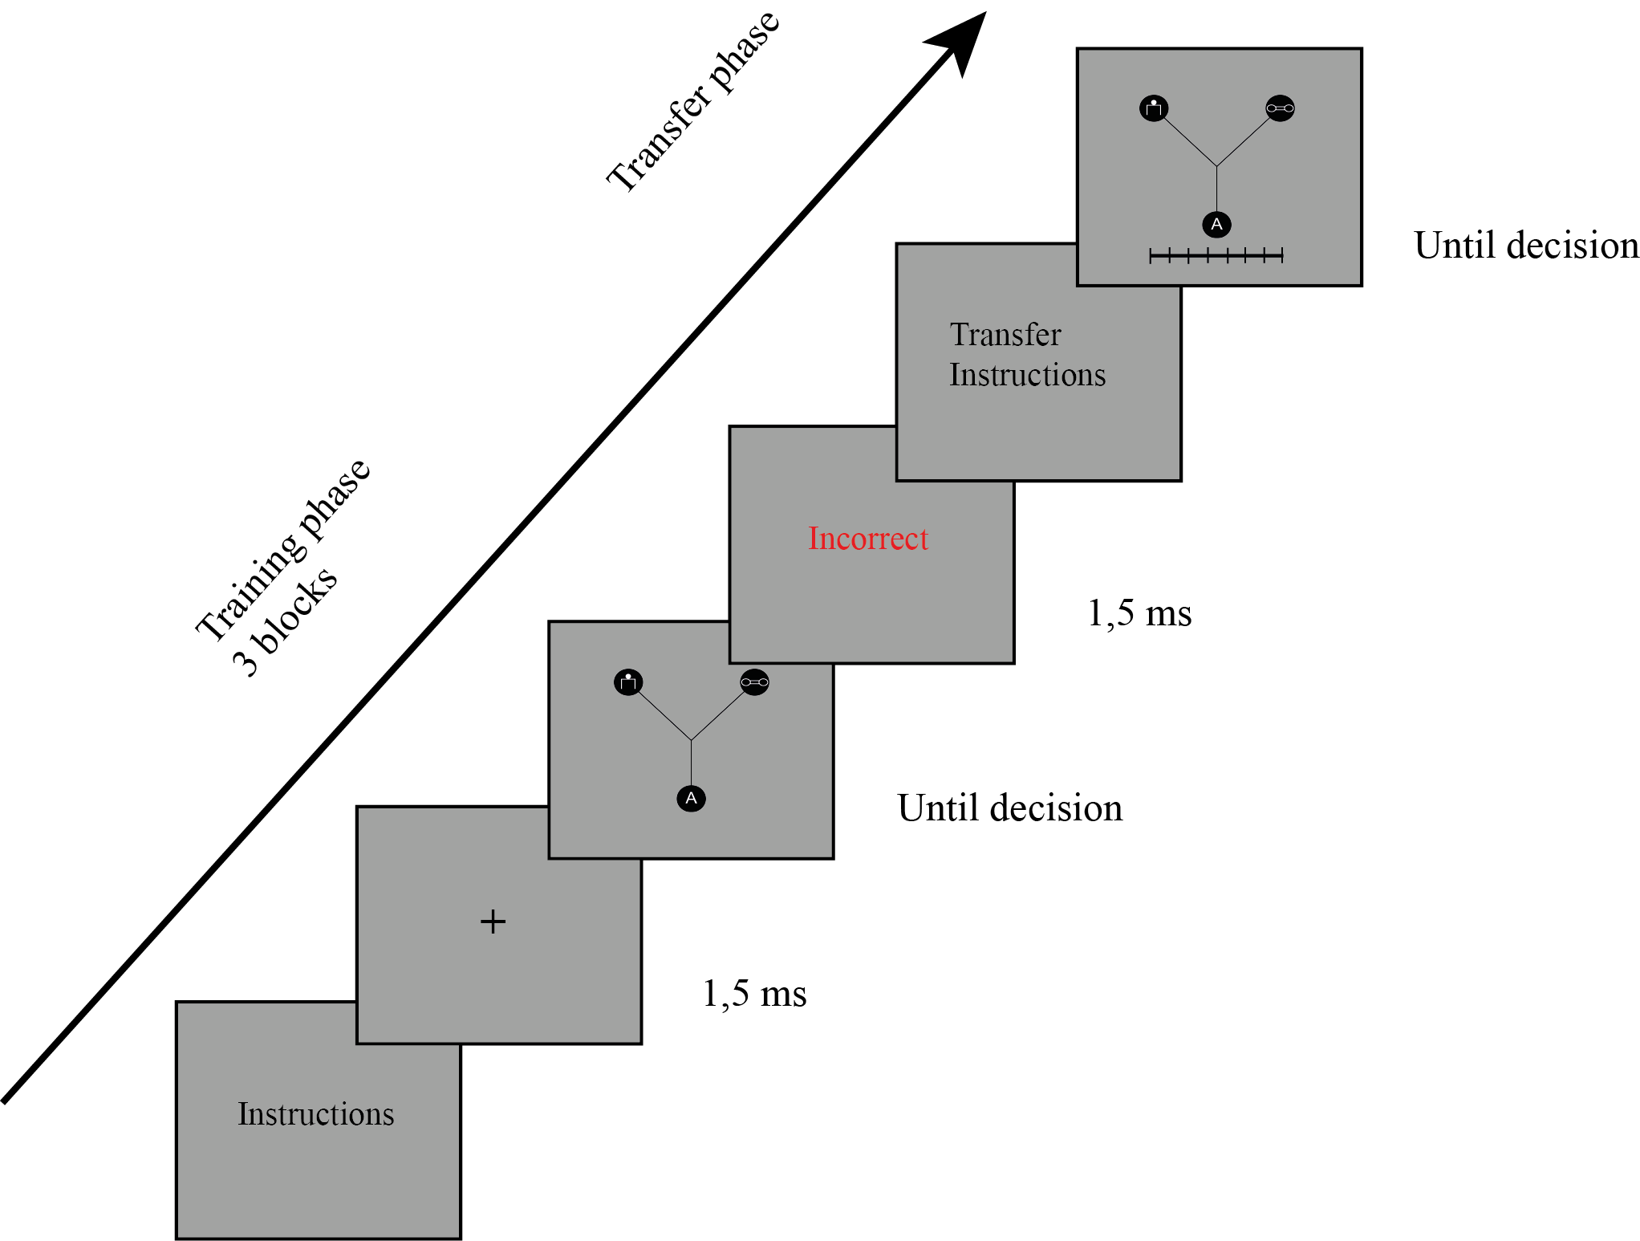
Current experiment
Experiment is divided by training phase (3 blocks, 80 trials each) and a transfer phase (8 trials with a rating scale).
By implementing individualized regression on rating scale (Rehder & Hastie, 2001; Puebla & Chaigneau, 2014). We could predict if the participants have learnt to allocate attention throughout learning.
Thus, promoting a top-down processing on classification by the bottom-up activation of the perceived internal category structure.

Slide 13
Future directions
Implement the experimental protocol using eye-tracker:
Eye fixation on ROI
Saccades
Between-subject design with different attentional weight on features.
Cognitive modeling on performance (promoting fits like ALCOVE)
Implement using EEG:
Feedback related negativity (Feedback discounting).
Source reconstruction on medial temporal lobe, occipital cortex and the PFC.
Implement real world categories.

